Slide 1
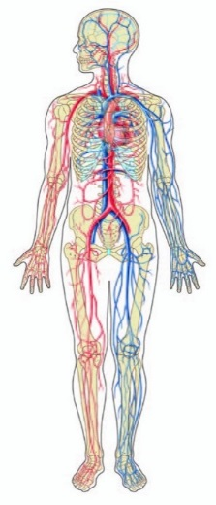
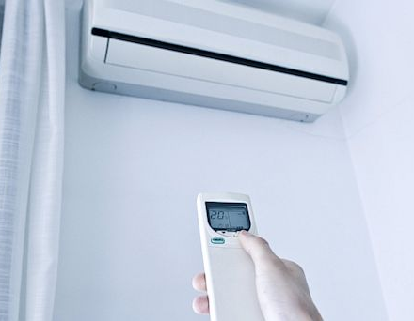

INTRODUCTION TO CONTROL SYSTEMS: WHAT IS A CONTROL SYSTEM?
Control is the process of causing a variable to behave to some desired way over time.
Control variable example: temperature, altitude, speed, concentration
CAN YOU THINK OF ANY CONTROL SYSTEM AROUND YOU RIGHT NOW?
Notes:
Pancreas: Regulates blood glucose level
Adrenaline: Automatically generated to increase the heart rate and oxygen in times of flight
Eye: Follow moving object
Hand: Pick up an object and place it at a predetermined location
Temperature: Regulated temperature of 36°C to 37°C

Slide 2
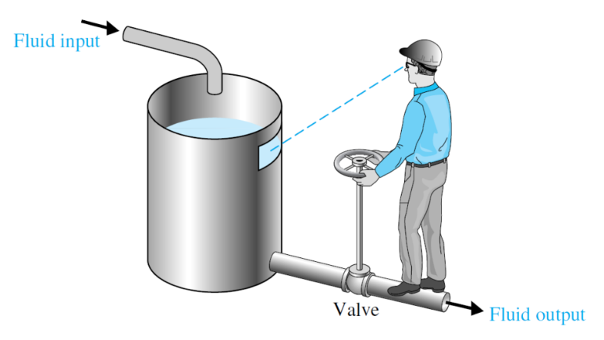
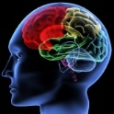
INTRODUCTION TO CONTROL SYSTEMS: KEY COMPONENTS/FUNCTIONS
1. Measurement
Measure variable being controlled – visual
2. Comparison
Compare measured/desired values – brain
3. Computation
What action and how much – brain
4. Correction
Perform action – hand rotates valve
1
2
3
4
2
3
4
COMPARISON
COMPUTATION
CORRECTION
-
Controller
Actuator
Process
Desired water level
Actual Output (water level)
1
MEASUREMENT
Sensor

Slide 3


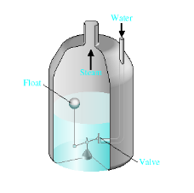
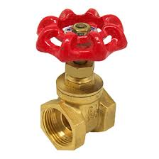

INTRODUCTION TO CONTROL SYSTEMS: MANUAL Vs. AUTOMATIC CONTROL SYSTEM
MANUAL CONTROL SYSTEM
Disturbance
Controlled Signal
Manipulated Variable
Error
+
+
Actual Output
Set-point or Reference input
+
Controller
Actuator
+
+
Process
-
Sensor
Feedback Signal

Slide 4
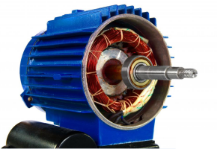
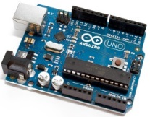
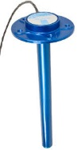
INTRODUCTION TO CONTROL SYSTEMS: MANUAL Vs. AUTOMATIC CONTROL SYSTEM
AUTOMATIC CONTROL SYSTEM
Disturbance
Controlled Signal
Manipulated Variable
Error
+
+
Actual Output
Set-point or Reference input
+
Controller
Actuator
+
+
Process
-
Sensor
Feedback Signal

Slide 5
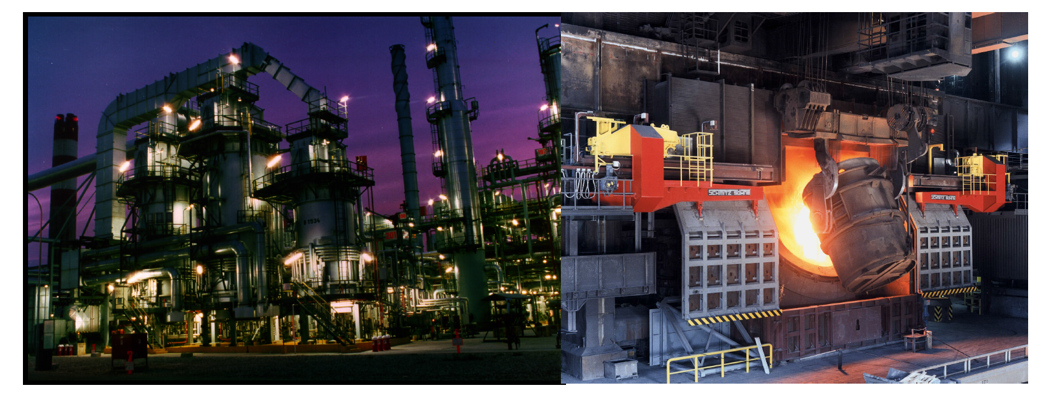
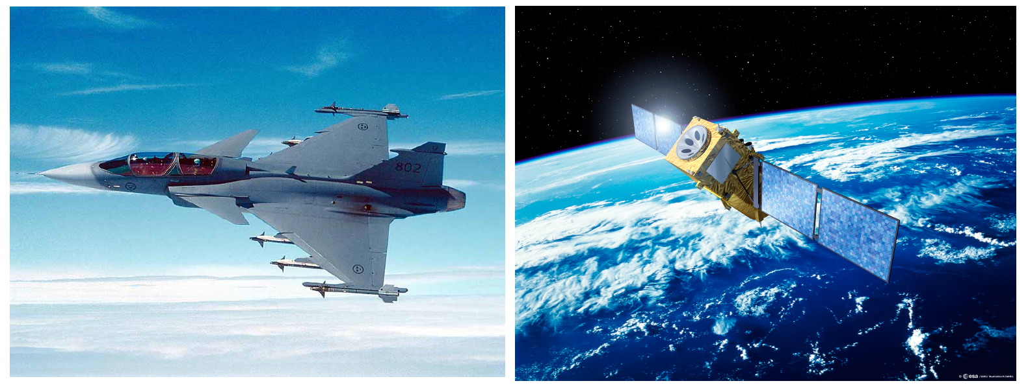
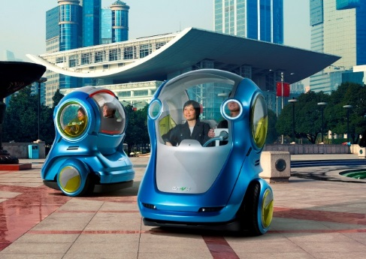
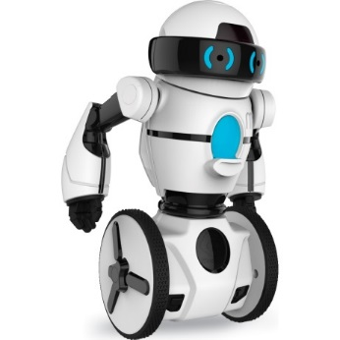
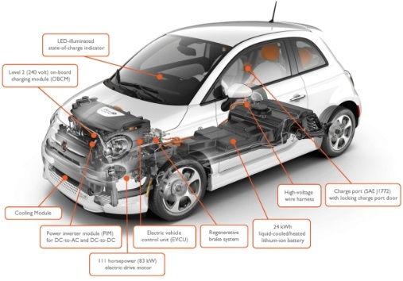
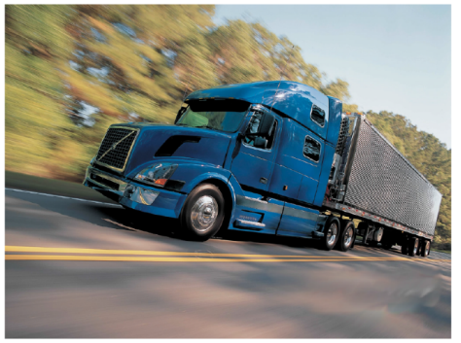
INTRODUCTION TO CONTROL SYSTEMS: APPLICATIONS
PROCESS INDUSTRY
AEROSPACE
AUTONOMOUS ROBOTS/VEHICLES
VEHICLES/POWERTRAIN

Slide 6
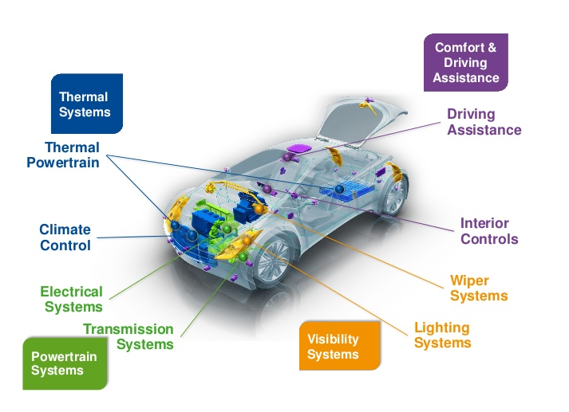
INTRODUCTION TO CONTROL SYSTEMS: APPLICATIONS/VEHICLE CONTROLLERS
WHAT CONTROL FUNCTIONS EXIST IN A TYPICAL VEHICLE?
Temperature control
Cruise control
EGR control
Electronic fuel injection
Throttle body Control
Active suspension
Electric power steering
Anti-lock brakes
Electronic ignition
Air bags
Electronic transmission
Notes:
Each ECU has several jobs: controlling the engine or transmission, rolling up windows, unlocking doors, and the like. These computers have sensors and switches wired in to detect variables such as temperature, pressure, voltage, acceleration at different angles, braking, yaw and roll of the vehicle, steering angle, and many other signals. When an ECU needs a signal from a sensor connected to an ECU elsewhere in the car, that's where CAN comes in.

